Slide 1



( Annexure V )
Project Presentation of Back End Engineering Project (BEE) (22CS026)
On
Hostelers’ Emporium
Mridul Gupta Kirti Goel Nishtha Nanda Muskan Bandta
2210991940 2210991805 2210991994 2210991947 .
Supervised By
Dr. Rajdavinder Singh Boparai and Mr. Aniket Methi
Department of Computer Science and Engineering, Chitkara University, Punjab

Slide 2
Introduction
Purpose: Hostelers' Emporium is designed for hostel residents to buy and sell essential items like chairs, notes, and late-night snacks.
Frontend: Uses React to create an engaging, responsive user interface.
Backend: Powered by Express.js for efficient server-side operations.
Storage: Utilizes a file system for straightforward, cost-effective data management.
Goal: Simplify transactions, connect hostel residents, and enhance the hostel experience.
Impact: Provides a convenient platform tailored to the specific needs of hostel life.

Slide 3
S/W, H/W Requirement
Software Requirements:
Frontend: React, Node.js (LTS version), npm or Yarn for package management
Backend: Express.js, Node.js (LTS version), npm or Yarn
Storage/Database: File system for storing data and resources
Hardware Requirements:
Development: Dual-core processor, 8 GB RAM, and 10 GB of free disk space. A stable internet connection is needed for package downloads and updates.
Production: Multi-core processor, at least 4 GB RAM, and sufficient storage based on data needs. Reliable internet connectivity is essential for server access and smooth operation.

Slide 4
Feasibility study
Technical: Using React for the frontend and Express.js for the backend is viable, offering a robust, scalable solution with broad community support. File system storage is cost-effective but may need upgrading as the user base grows.
Operational: Requires skilled developers and standard tools. Deployment on cloud platforms or hosting services is practical with necessary server and data management strategies.
Economic: Low initial costs due to open-source technologies. Ongoing costs include server hosting and maintenance.
Legal: Compliance with data protection laws and licensing agreements is essential.
Market: Targeting hostel residents with validated needs and analyzing competitors will ensure market fit.

Slide 5
Techniques Used /Tools Used
Frontend: React for building a dynamic, responsive user interface, leveraging components and state management for a seamless experience.
Backend: Express.js on Node.js for a lightweight, efficient server-side application, handling API requests and server logic.
Storage: File system for storing and managing user data and resources, ensuring straightforward, cost-effective data handling.
Development Tools: Node.js and npm/Yarn for package management and dependency handling. Git for version control and collaboration.
Deployment: Cloud platforms (e.g., AWS, Heroku) or traditional hosting services for reliable application deployment and scaling.

Slide 6
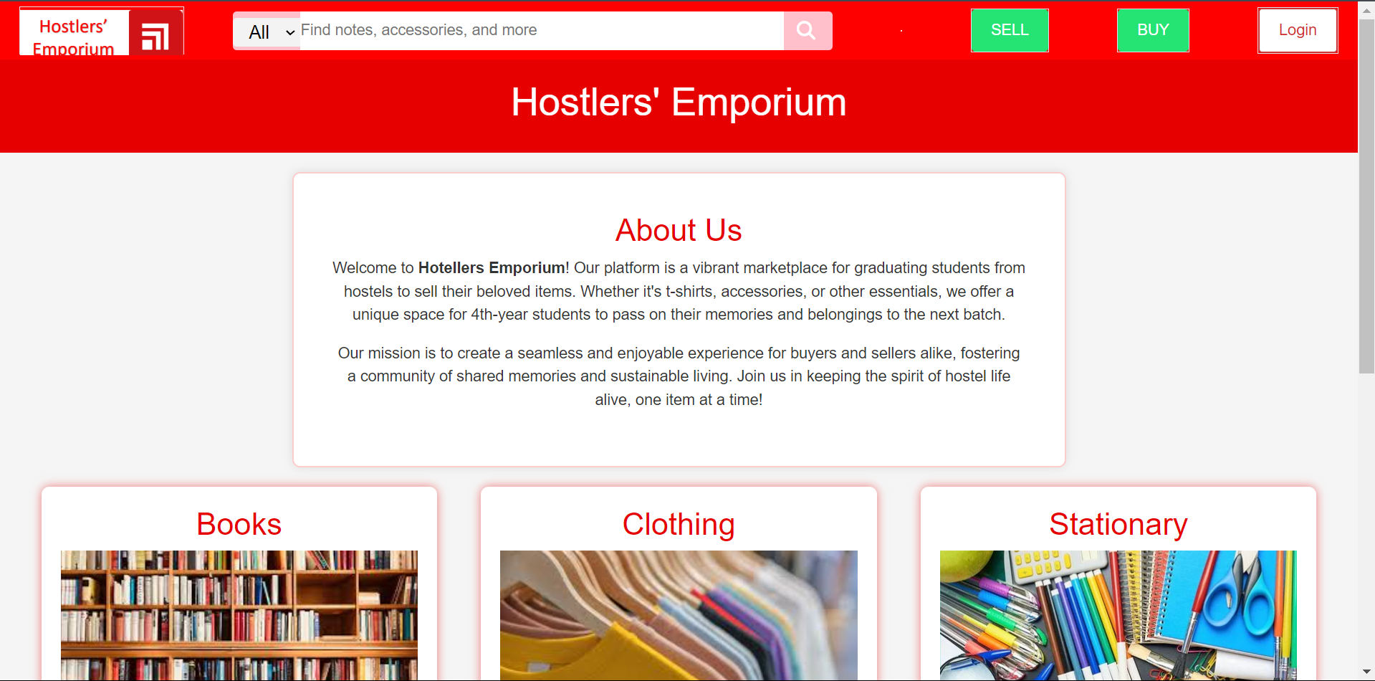
Design

Slide 7
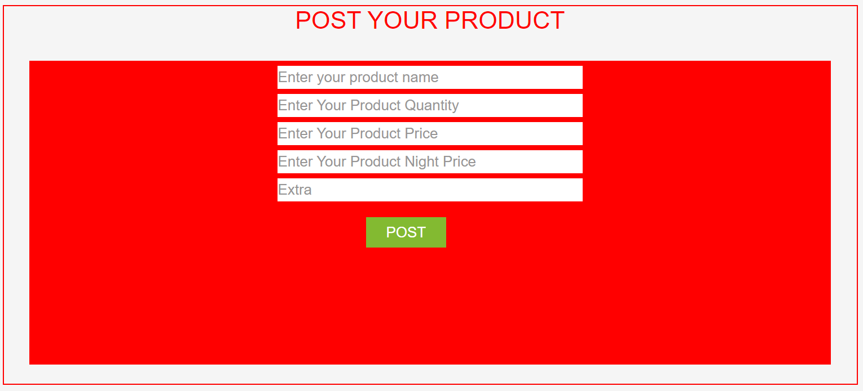
Design

Slide 8
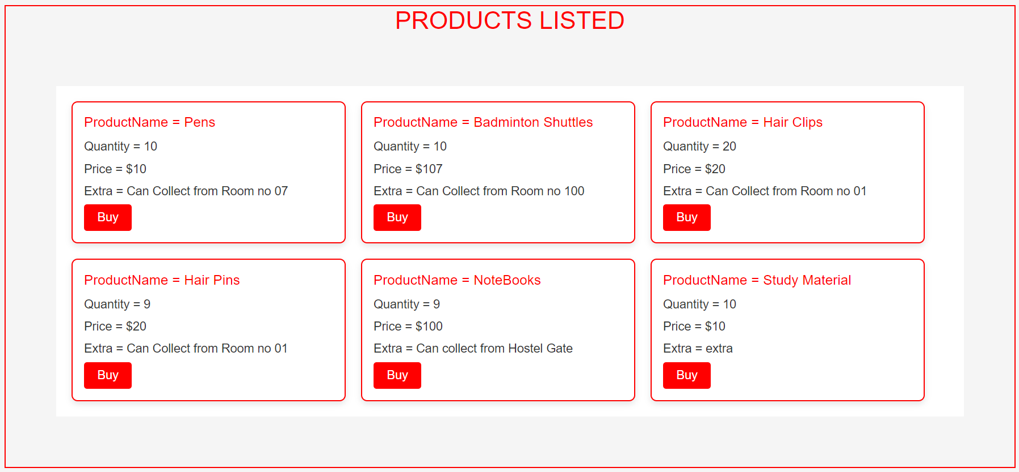
Design

Slide 9
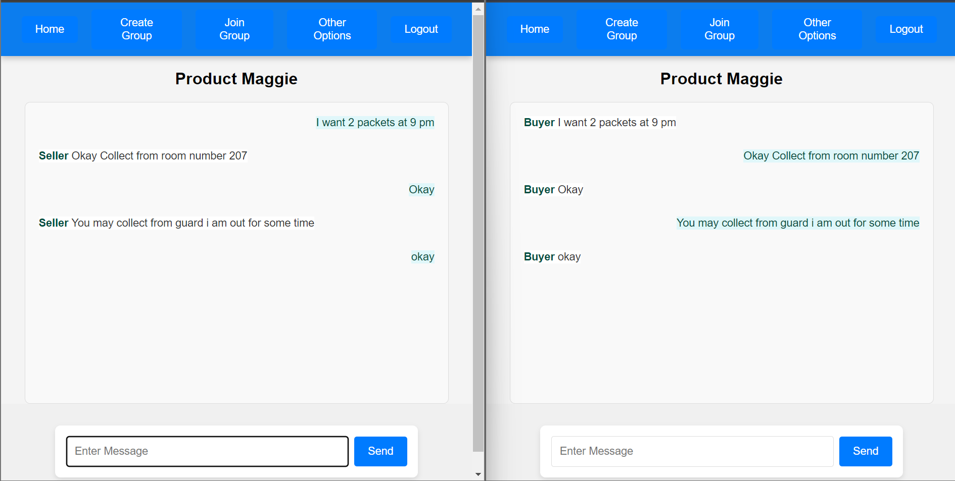
Design

Slide 10
Results
User Engagement: Hostelers' Emporium successfully attracted a diverse user base of hostel residents, providing a valuable platform for transactions.
Interface Performance: React-driven frontend delivered a responsive and intuitive user experience, enhancing user satisfaction.
Backend Efficiency: Express.js backend handled API requests and server operations smoothly, ensuring reliable performance.
Data Management: The file system effectively managed storage needs, accommodating current data requirements.
Deployment Success: Cloud-based deployment ensured stable access and scalability, supporting increased user activity.
Positive Feedback: Users appreciated the platform's functionality and ease of use, validating the project’s design and impact.

Slide 11
Conclusion
Successful Implementation: Hostelers' Emporium effectively meets the needs of hostel residents with its user-friendly interface and efficient backend.
Tech Stack Efficiency: React and Express.js provide a robust, scalable solution, while the file system handles data management effectively.
User Feedback: Positive responses highlight the platform's ease of use and valuable functionality for buying and selling items.
Scalability: Deployment on cloud platforms ensures reliable performance and growth potential.
Overall Impact: The project enhances hostel life by simplifying transactions and fostering community connections, validating its design and development approach.

Slide 12
Thank You

